Slide 1
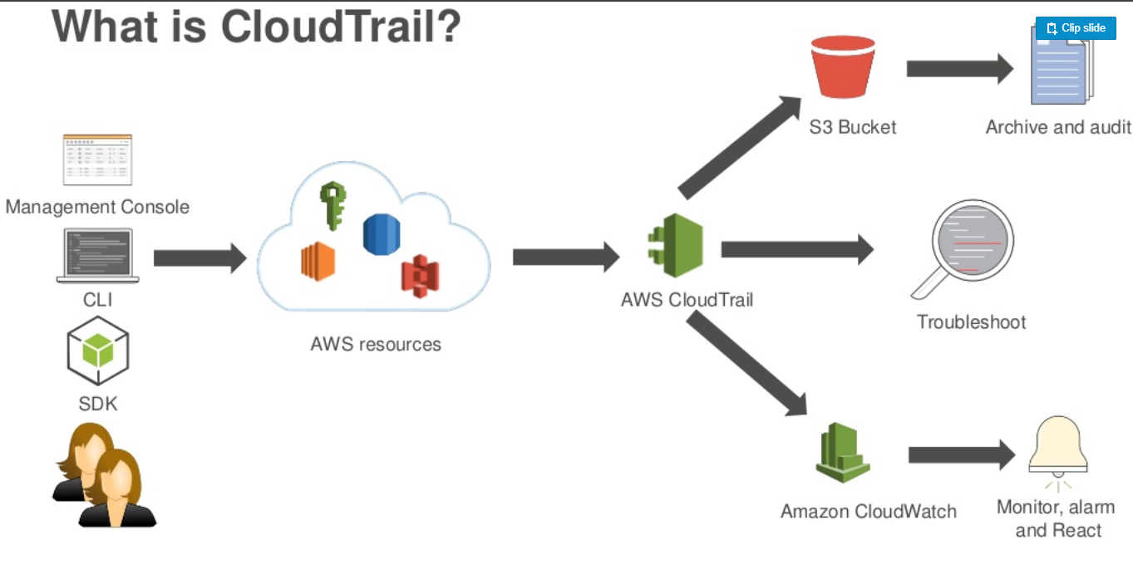
Cloud trail
AWS CloudTrail is an AWS service that helps you enable governance, compliance, and operational and risk auditing of your AWS account.
Actions taken by a user, role, or an AWS service are recorded as events in CloudTrail.

Slide 2
Events include actions taken in the AWS Management Console, AWS Command Line Interface, and AWS SDKs and APIs.
CloudTrail is enabled on your AWS account when you create it.
When activity occurs in your AWS account, that activity is recorded in a CloudTrail event.
You can easily view events in the CloudTrail console by going to Event history.
Event history allows you to view, search, and download the past 90 days of activity in your AWS account.
Next, from the Advanced section, you can optionally configure a Log file prefix. By default, the logs will automatically get stored under a folder-like hierarchy that is usually of the form AWSLogs/ACCOUNT_ID/CloudTrail/REGION.
You can also opt to Encrypt log files with the help of an AWS KMS key. Enabling this feature is highly recommended for production use.

